Slide 1
Software Architecture and Design I SOEN 343 Instructor: Dr. Rodrigo Morales https://moar82.github.io/ rodrigo.moralesalvarado@concordia.ca
Lecture 3a. Use Cases
Notes:
1

Slide 2
Learning objectives (1)
Understand the role of use cases for requirements specification
Understand the main benefits of use cases, compared with other specification forms
Understand the main concepts behind use cases, including actors, goals, and scenarios
Understand how use cases are iteratively refined (and implemented) in an UP project

Slide 3
Learning objectives (2)
Understand how to systematically build a use case model
Understand how to find actors and learn the difference between primary and secondary actors
Understand the concept of goals and how they relate to actors and use cases
Learn how to identify different goal levels, in particular the user-goal and subfunction-goal levels
Understand how to separate the main success scenario from other scenarios
Learn about UML use case diagrams and use case context diagrams

Slide 4
Learning objectives (3)
Learn how to refine use cases into “fully-dressed” specifications
Learn about subfunction goal-level use cases and how they relate to user-goal level use cases
Learn about the «extend» and «include» relations between use cases
Learn how to define pre- and post-conditions in use cases
Learn how to describe stakeholders’ interests within a use case
Learn how to connect use cases with non-functional requirements
Learn about writing rules and checklists for use case specifications
Understand how use cases are handled in design and implementation in the UP

Slide 5
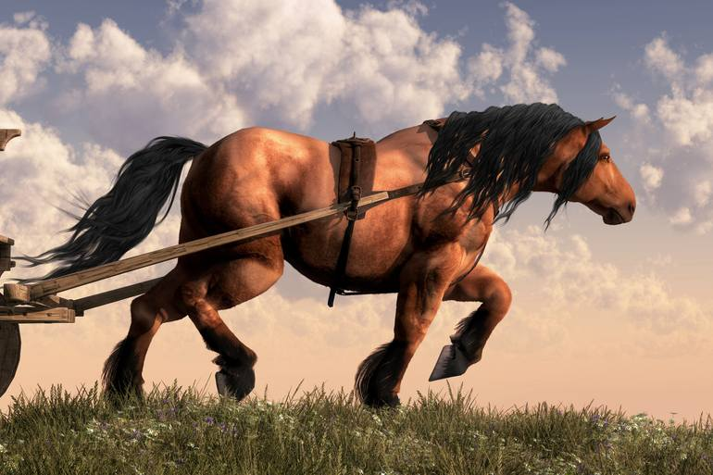
Introduction
While it is true that not everything that matters about requirements is a use case, it is also true that the use case will be the requirement’s workhorse
A use case describe sequences of actions a system perform that yield an observable result of value to a particular actor

Slide 6
Use cases: Features
Are part of the SRS
Contain actors
Describe an observable value delivered by the system to an actor
Capture functional requirements
Are derived from the Vision Document in the UP process
Collect a number of (positive) scenarios, both normal and abnormal

Slide 7
Why Use Cases?
“Old-style ” SRS just have long list of requirements structured by sub-system:
2.1 Data Entry
2.1.1 Data Entry Subsystem
2.1.1.1 User shall login to system
...
2.2 Report Generation
...
2.2.4.2.1 Reports must be sortable by due date or entry date
Commonly associated with Waterfall model
Notes:
Problem with this?
After reading dozens [hundreds] of pages of these, you still have no idea what the system is actually doing!
Because they lack context and cohesion

Slide 8
Real life example: NASA
WIRE C&DH Flight Software Requirements Specification
041.1.1 The flight software shall receive data in the form of CCSDS packets from the Software Bus and shall transmit the data over the 1553B bus.
041.1.2 The flight software shall collect data from the 1553B remote terminals and shall transmit the data on the Software Bus in the form of CCSDS packets.
041.1.3 If necessary, the flight software shall use multiple 1553B transactions to collect or transmit a single CCSDS packet.
https://web.archive.org/web/20111015090659/http://sunland.gsfc.nasa.gov/smex/wire/mission/cdhsw/wirrqtop.htm

Slide 9
The benefits of use cases
Compared to traditional requirements methods, use cases are relatively easy to write and easier to read
Use case force developers to think through the design of a system from the perspective of a user
They provide an ordering mechanism for requirements
They are critical tool in the analysis, design, implementation and testing process
They also serve as inputs to the user documentation, conveniently organized in a step-by-step format

Slide 10
Use cases elements
Actor: something with behavior, such as a person, computer system, or organization, e.g., a cashier
Scenario: a specific sequence of actions and interactions between actors and the system under discussion, e.g., the scenario of successfully purchasing items with cash
Use Case: a collection of related success and failure scenarios that describe actors using a system to support a goal

Slide 11
Use case example
UC: Handle returns
Main success scenario:
A customer arrives at a checkout with items to return. The cashier uses the POS system to record each returned item…
Alternate scenarios:
If the credit reimbursement authorization is rejected, inform customer and ask for an alternative payment method.
If item identifier not found in the system, notify the Cashier and suggest manual entry of the identifier code.
…

Slide 12
Building the Use Case Model step by step
Identify and describe the Actors
Identify the Use Cases and write a Brief Description
Identify the Actor/Use Case Relationships
Outline the Individual Use Cases
Refine the Use Cases

Slide 13
Building the Use Case Model step by step
Identify and describe the Actors
Identify the Use Cases and write a Brief Description
Identify the Actor/Use Case Relationships
Outline the Individual Use Cases
Refine the Use Cases

Slide 14
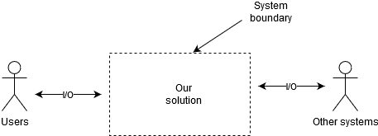
System Boundary is the context
Notes:
System Boundary defines the border between the Solution (our system) and the Real World (things that interact with our system).
World partitioned (i.e., no sharing) in two:
+Our system
+Things that interact with our system

Slide 15

How to identify Actors
Who will supply, use, or remove information from the system?
Who will operate the system?
Who will perform any system maintenance?
Where will the system be used?
Where does the system get its information?
What other external systems will interact with the system?

Slide 16
Primary vs Secondary actors
Primary actor:
Interacts to achieve required system function and derives the intended benefit from the system
Works directly and frequently with the system
Usually positioned on the left side of the Use case diagram
Secondary actor:
Supports the system so that primary actors can do their job
Usually positioned on the right side of the Use case diagram

Slide 17
Building the Use Case Model step by step
Identify and describe the Actors
Identify the Use Cases and write a Brief Description
Identify the Actor/Use Case Relationships
Outline the Individual Use Cases
Refine the Use Cases

Slide 18
Example: Wings over the world company
Vision (Objectives and Goals)
Wings Over the World endeavors to maintain its reputation for innovation by increasing access to our travel services and by offering new and innovative services that are unmatched by our competitors. Specifically:
Increase brand awareness of Wings Over the World with the creation of a public web site
Increase market share by 15 percent and lower the cost of booking tickets by letting 30 percent of our clients to book on-line.
Open the Wings Over the World travel system to independent travel agents by offering premium booking services and therefore create a new revenue stream

Slide 19
Context diagram (not UML)
Customer
Ticket
wholesaler
Wings
Over
The
World
Customer
Assistance
Bank
Notes:
a possible starting point for building the Use Case set

Slide 20
User-Goal Level use cases
Satisfies a particular and immediate goal of value to the primary actor
Examples:
Wings over the world user-level use cases:
Book Flight
Book Hotel
Writing Rule: Name the use case with an active verb phrase that represents the goal of the primary actor
Use Case Brief: A simple, one-paragraph story describing the main success scenario for the use case

Slide 21

Example: Book Flight
UC: Book Flight
Actor: Travel agent
The travel agent retrieves a client’s reservation and books the flight. The agent examines the aircraft seat map and selects the client’s preferred seats in the aircraft. The agent enters the client’s payment information, and the system books and assigns the seats. The system prints tickets

Slide 22
Building the Use Case Model step by step
Identify and describe the Actors
Identify the Use Cases and write a Brief Description
Identify the Actor/Use Case Relationships
Outline the Individual Use Cases
Refine the Use Cases

Slide 23
How to do it?
First identify the actors and their goals
Actors: What computers, subsystems and people will drive our system?
Goals: What does each actor need our system to do?
Each goal shows up as a trigger to a usage (use case) of our system.
Result: A list of use cases, a sketch of the system
Short, almost complete list of usable system function

Slide 24
Wings Over the World: Actors and Goals
Actor | Goals
Agent | Reserve flight Book flight Cancel flight reservation Request upgrade Open passenger profile Close passenger profile
Airline | Cancel flight Discount flight

Slide 25
Actor-Goal list
Initial List
Actor | Goal (use case)
User | Login Submit report
Administrator | Login Submit report Add Users Remove Users …

Slide 26
Actor-Goal list
Refined List (User-goal level)
Actor | Goal (use case)
User | Login Submit report
Administrator | Login Submit report Add Manage Users Remove Users …

Slide 27

The boss test
Your boss asks, “What have you been doing all day?’
You reply: “Logging in!”
Is your boss happy?
If not, your use case failed the Boss test (as it does not deliver measurable value to the user)
Notes:
Helps to determine if a Use Case is user-goal level or not:

Slide 28
The EBP Test
Check if UC is an Elementary Business Process (EBP)
A task performed by one person in one place at one time, in response to a business event, which adds measurable business value and leaves the data in a consistent state, e.g., Approve Credit
Don’t confuse use cases with “functions” (like entries in a menu – add order, delete order, update order, …)

Slide 29
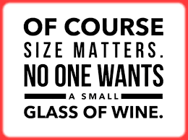
The size test
Typically a UC has many steps
In “fully dressed” format, can be elaborated to 3-10 pages or more
If you end up with only 1-2 steps, this is most likely not a valid use case

Slide 30
Wings Over the World: Actors and Goals
Actor | Goals
Agent | Reserve flight Book flight Cancel flight reservation Request upgrade Open passenger profile Close passenger profile
Airline | Cancel flight Discount flight

Slide 31
Exercises to reflect
Test the following use cases:
Negotiate a strategic company alliance
Handle returns
Log in
Update piece on game board

Slide 32
Building the Use Case Model step by step
Identify and describe the Actors
Identify the Use Cases and write a Brief Description
Identify the Actor/Use Case Relationships
Outline the Individual Use Cases
Refine the Use Cases

Slide 33
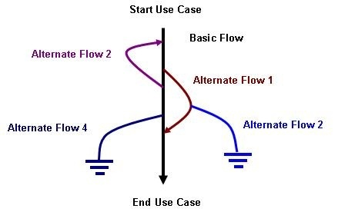
Outline the individual Use cases
Outline the basic flow first (black line)
Basic flow
What event starts the use case?
How does the use case end?
How does the use case repeat some behavior?
Alternate flow:
Are there optional situations in the use case?
What odd cases might happen?
What may go wrong?
What may not happen?
What kind of resources can be blocked?
Notes:
The next step is to outline each use case so you can start to gain an understanding of required system behavior at the next level of detail. As you do so, you also start to understand various alternatives and events that can occur as part of the systems operation. Of interest at this time is the flow of events,
(Some call this the "happy day" flow since there are no problems and no exceptions on this path.) including the basic and alternate flows.)

Slide 34
User goal Main Success Scenario
UC: Book Flight
Level: User Goal
Main Success Scenario
This use case begins when a customer calls and requests a flight
The customer describes her flight needs by specifying her origination, destination, travel dates and preferred departure times
The system looks up all flights that match the customer’s travel preferences and presents the travel options to the customer
The customer selects a flight
The system builds a flight itinerary for the customer.
The system reserves the flight for the customer
The customer provides a credit card number and charges the price of the flight against it
The system issues the ticket to the customer

Slide 35
Some use case writing rules
Each scenario begins with a triggering action that the system can detect:
ATM Withdraw Cash Main Success Scenario
1. Customer inserts the card.
2. ...
Steps should not be too small
Stepping up to the sidewalk Main Success scenario
1. She lifts her foot from the street to the curb.
2. She arcs the foot through the air, and lowers to the pavement
Keep scenarios to three to nine steps, all at a level of abstraction just below the use case goal

Slide 36
Essential vs Concrete style
Essential
Focus on intent: Avoid making UI decisions
Concrete
UI decisions are embedded in the use case text: “Admin enters ID and password in the dialog box (see picture X)”
Concrete style not suitable during early requirements analysis work

Slide 37
UML and the use case model
Use case diagram
UML defines the Use case diagram, but doesn’t explain how write actual use cases!
Use cases are text documents, not diagrams
Use-case modeling is primarily an act of writing text, not drawing diagrams

Slide 38
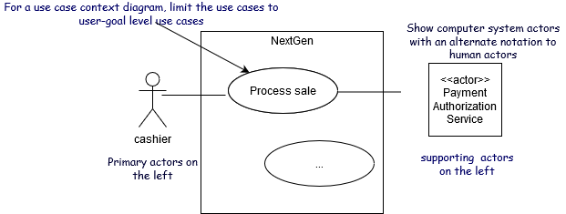
Use case Diagram as a Context Diagram: POS

Slide 39
Relating Use cases
The include relationship
partial behavior that is common across several use cases (models required behavior)
separate it into its own Subfunction Use Case, and indicate its inclusion
Included sub-function shared across several use-cases (duplicated parts!)
The extend relationship
separate it into its own Subfunction Use Case
indicate where and under what condition it extends the behavior of some base use case (it models optional behavior)
Original use case remains untouched
Extended functionality may be optional

Slide 40
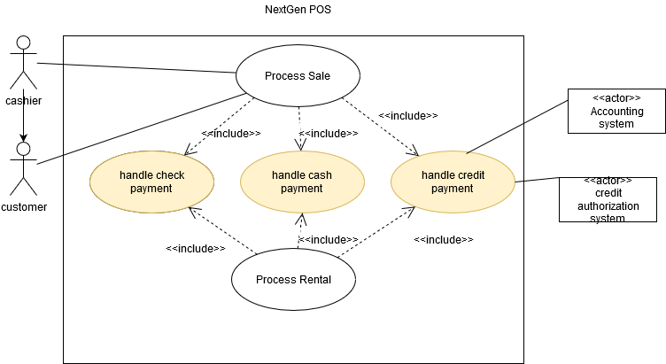
UML: Using «include» Relationship
Common sub-behavior

Slide 41
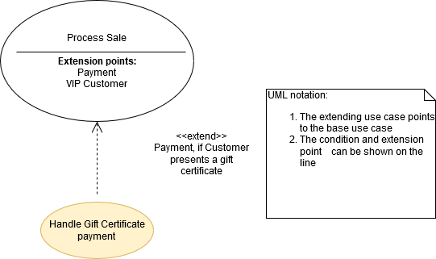
UML: Using Extend Relationship
Common sub-behavior

Slide 42
Building the Use Case Model step by step
Identify and describe the Actors
Identify the Use Cases and write a Brief Description
Identify the Actor/Use Case Relationships
Outline the Individual Use Cases
Refine the Use Cases

Slide 43
Refine use cases
At some point later in the project lifecycle, the time will be right to refine the use cases to the next and last level of detail
All alternate flows, including exception conditions
"What if the remote server is down?“
All these exceptions must be documented in the use case or the application may not behave as expected
Pre- and post-conditions
A pre-condition to programming vacation settings might be that the user has set the calendar clock
Post-condition example: the programmed vacation schedule, which reflects that actual input by the homeowner, must be saved by the system to be recalled for later use.
Notes:
in software development, the "what ifs" become a primary source of concern, and these must be fully explored in alternate flows.

Slide 44
Process Sale: User Level Use Case Example
Preconditions:
Cashier is identified and authenticated.
Success Guarantee (Postconditions):
Sale is saved.
Tax is correctly calculated.
Accounting and Inventory are updated.
Commissions recorded.
Receipt is generated.
Payment authorization approvals are recorded.

Slide 45
Fully dressed use cases template
Use case section | Comment
Use Case Name | Start with a verb
Scope | The system under design
Level | “User-level” or “subfunction”
Primary Actor | Calls on the system to deliver its services.
Stakeholder and interests | Who cares about this use case, and what do they want?
Preconditions | What must be true on start, and worth telling the reader?
Success Guarantee | What must be true on successful completion, and worth telling reader?
Main Success Scenario | A typical, unconditional happy path scenario of success.
Extensions | Alternate scenarios of success or failure.
Special Requirements | Related NFRs
Technology and Data Variations list | Varying I/O methods and data formats.
Frequency of Occurrence | Influences investigation, testing, and timing of implementation.
Misc. | Such as open issues.

Slide 46
More use case writing rules
Use cases do not collect formulas, state, cardinality
Bad examples:
Order sum = order item costs * 1.06 tax. (design issue)
Promotions may not run longer than 6 months. (business rule)
Customers only become ‘Preferred’ after an initial 6-month period. (business rule)
Write in an UI-free style
Bad examples:
Systems displays the “edit users” window (see Figure 1). (design issue)
Focus on intent
Bad examples:
Administrator enters ID and password in dialog box.
(Better: 1. Administrator identifies self.)

Slide 47
Conclusion
Writing good use cases is a creative task
You are describing a systems that does not yet exist!
This requires vision and creativity
Don’t start to analyze structure or implementation
Synthesize instead of Analyze!
Take time to understand the domain
Understand the software development involved
Assign people to writing Use Cases with good technical writing skills

Slide 48
References
Chapter 14, 21 and appendix C., Dean Leffingwell, Don Widrig: Managing Software Requirements: A Use Case Approach. 2nd ed., Addison-Wesley, 2003.

